Slide 1
Next Word Prediction Model Using Python
Course Title : Artificial Intelligence Lab
Course code : CSE-316
Redefining Roles in the Age of Artificial Intelligence+"
Notes:
Assalamualaikum and a very good morning everyone….
Thank you for joining us today….
we will be presenting project "Next Word Prediction Model Using Python"
of the course CSE 316, titled: Artificial Intelligent lab……
But before that We’d like to express our gratitude towards our honorable course instructor, MS. Farjana Akter Jui, ma'am,
Lecturer of department of CSE, GUB
for giving us the opportunity to present today.

Slide 2


OUR TEAM
TARIKUL ISLAM
FARZANA YEASMIN
ID : 212002008
BATCH : 212-D1
DEPT. OF CSE
Green University of Bangladesh
ID : 212002009
BATCH : 212-D1
DEPT. OF CSE
Green University of Bangladesh

Slide 3
TABLE OF CONTENTS
01
02
03
04
04
Project Introduction
Feature
Tools & Technique
Coadding Screenshot
Future Work

Slide 4
INTRODUCTION
The Next Word Prediction Model is an essential component of modern text-based applications, enhancing user experience by providing contextually relevant suggestions as users type.
Notes:
Introduction:
The Next Word Prediction Model is an essential component of modern text-based applications, enhancing user experience by providing contextually relevant suggestions as users type. This project aims to develop a robust next word prediction system using Python, leveraging natural language processing (NLP) and machine learning techniques. By analyzing patterns in large text corpora, the model can predict the most probable next word, facilitating efficient text input, reducing typing effort, and improving the overall usability of applications such as messaging platforms, search engines, and text editors. The project will explore various algorithms and models, including n-grams, neural networks, and transformers, to achieve high accuracy and responsiveness in real-time prediction scenarios.
Now i like to invite Farzana to continue...

Slide 5
Features
Load and process images/videos
Use pre-trained models (YOLO, TensorFlow Object Detection API)
Train custom models
Detect bounding boxes around objects
Classify objects with labels
Real-time processing
Visualize output with bounding boxes and labels
Notes:
The project loads and processes images and videos, utilizing pre-trained models like YOLO and TensorFlow Object Detection API for object detection. It supports training custom models, detects objects with bounding boxes, classifies them with labels, and enables real-time processing. The output is visualized with bounding boxes and labels for clear understanding.

Slide 6
Tools and technique
Here are the key tools and technologies we'll leverage for our project-
Python Programming Language
Python Library- Panda, NumPy, TensorFlow-keras
Custom Data Set
software - Kaggle
Notes:
Here you can see the key tools and technologies we'll leverage for our project-
Python Programming Language
Python Library- Panda, NumPy, TensorFlow-keras
Custom Data Set
software - Kaggle

Slide 7
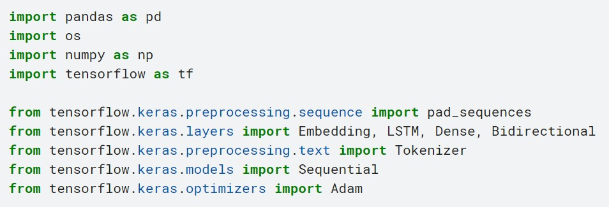

Coding screenshot
Notes:
Importing necessary libraries:
-pandas for data manipulation.
-os for operating system dependent functionality.
-numpy for numerical operations.
-tensorflow for machine learning and deep learning tasks.
Importing specific functions and classes from tensorflow.keras:
-pad_sequences to pad sequences to a common length.
-Sequential to create a linear stack of layers.
-Embedding, LSTM, Dense, Bidirectional to build the neural network layers.
-Adam for the Adam optimization algorithm.
-Tokenizer for converting text to sequences of tokens.
Loading the dataset from a CSV file using pandas.

Slide 8

Coding screenshot
Notes:
-Displaying the first few rows of the dataset to understand its structure.
-Displaying the last few rows of the dataset to see how it ends and check for any irregularities.
-Extracting the 'title' column from the dataset, which contains the text data we are interested in.

Slide 9
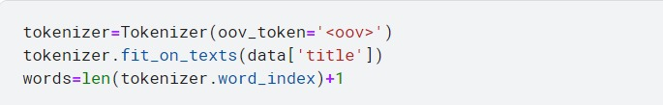
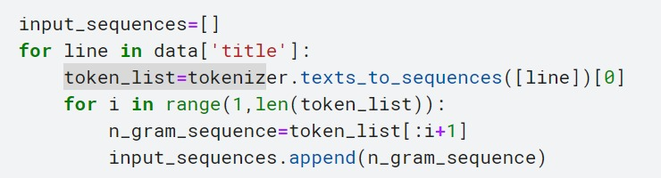
Coding screenshot
Notes:
1. Initializing a Tokenizer with an out-of-vocabulary token <oov> to handle words not seen during training.
2. Fitting the tokenizer on the text data in the 'title' column to build the word index.
3. Initializing an empty list to store the input sequences.alculating the total number of unique words in the dataset by getting the length of the word index and adding 1 for the out-of-vocabulary token.
4. Looping through each title in the 'title' column:
5. Converting each title to a sequence of tokens.
6.Creating n-gram sequences from the token list and adding them to input_sequences.
7.Printing the generated input sequences for verification.

Slide 10

Coding screenshot
Notes:
1. Finding the maximum sequence length among all input sequences.
2. Pads all sequences to the length of the longest sequence by adding zeros at the beginning, and converts the result to a NumPy array.
3. Displaying the third input sequence to inspect its structure.
4. Splitting input sequences into features (xs) and labels (labels):
-xs contains all tokens except the last one.
-labels contains the last token of each sequence.
5. Converting labels to one-hot encoded format, with the number of classes equal to the number of unique words.

Slide 11
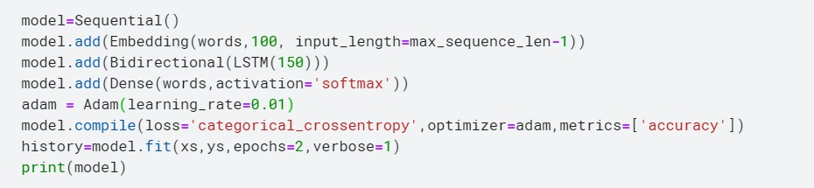
Coding screenshot
Notes:
In this particular part, we will be used to train our model.
In the given code snippet, a Sequential model is created using the Keras library to perform next word prediction. The model includes an Embedding layer, a Bidirectional Long short-term memory(LSTM) layer, and a Dense output layer with a softmax activation function.

Slide 12
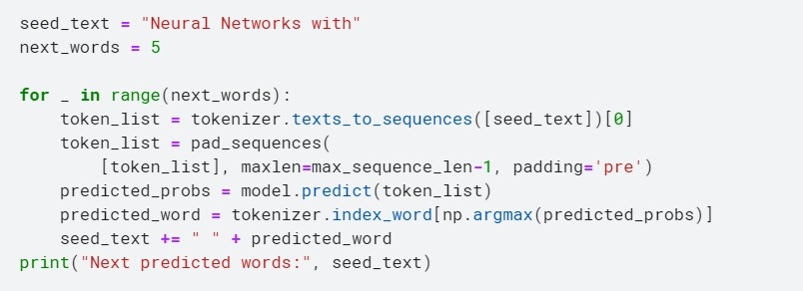
Coding screenshot
Notes:
In this particular part, we will be used to test our model.
The provided code snippet demonstrates how to generate the next words for a given input text using the trained model.

Slide 13
Future Work
The future of work promises exciting new environments that blend physical and virtual spaces. Here are some possibilities for where we might work:
Collaborative Co-working Spaces
Augmented Reality (AR) Workstations
Vertical Farms
Remote Work Hubs
Underwater Workplaces
Space Stations
Notes:
The future of work promises exciting new environments that blend physical and virtual spaces. Here are some possibilities for where we might work:
Collaborative Co-working Spaces
Augmented Reality (AR) Workstations
Vertical Farms
Remote Work Hubs
Underwater Workplaces
Space Stations

Slide 14
PROJECT SIMULATION

Slide 15
THANKS!
Do you have any questions?

